Slide 1

Facial Mask Detection System using ML
Group No.: 6
Harsh Saraiya – 18104006 Prajakta Mhaske – 18104036 Saloni Rane -18104009
Guided by
Prof. Kiran Deshpande Prof. Kaushiki Upadhyaya Prof. Nahid Shaikh

Slide 2
Contents
Introduction
Litrature Review
Objectives
Scope
Technology Stack
Block Diagram to propose project idea.
Demonstration (Desired)
References

Slide 3
1. Introduction
Problem Identified :
In this phase of covid-19 people are not following proper rules as a precautionary measure.
Though wearing masks is a compulsory action, It is not followed by people.
Solution Proposed :
To design a system which works to detect masked faces and unmasked faces in Covid-19 situation.
It will be a user-friendly system where a webcam or CCTV surveillance will record all the time and check to give an alert message.

Slide 4
2. Literature Review
Sr. No.
Authors
Paper Tittle
Methodologies
Findings
1.
MM Rahman
An Automated System to Limit
Deep Learning Architecture, Image
An automated smart framework for
COVID-19
Using Facial Mask Detection in Smart City Network
Pre-Processing
screening persons who are not using a face mask
2.
Mamata S. Kalas
Real time face detection and tracking using OpenCV
Harr like classifier and AdaBoost algorithm to track faces on OpenCV Platform.
Face detection is a two- class problem where we have to decide if there is a face or not in a picture. This approach can be seen as a simplified face recognition problem.

Slide 5
3. Objectives
To automate the process of face mask detection using a CCTV camera.
To Classify people into masked and unmasked category.
Image recognition of unmasked people and notification alert to the Authority about it.
To help stop the spread of airborne particles (corona virus) from the infected person’s sneezing or coughing by the use of our system.
To ensure a safe working environment by creating an atmosphere of awareness & preparedness in the locality.

Slide 6
4. Review Suggestions (Given in the last meeting)
To alter the Objectives of our Project.
To build a Mobile Application instead of Web Application and give an alert.
To deploy data on Cloud.

Slide 7
5. Scope
It can be deployed in the college campus area, for students, teachers and other college staff.
Can be used in housing complex, hospitals, and offices.

Slide 8
6. Technology Stack
- Python3, Jupiter Notebook, Google collab
- OpenCV, Tensorflow, Keras
- Firebase

Slide 9
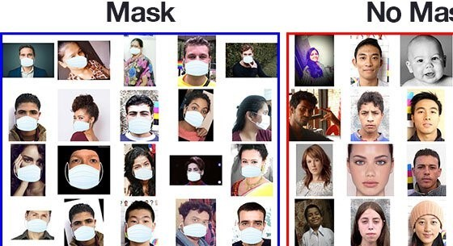
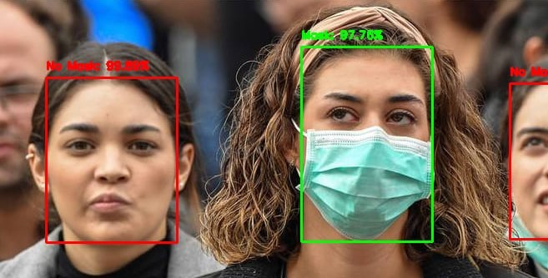
7. Block Diagram to propose project Idea
Phase I Phase II
Display face with Box Identification
Comparing Red with predefined dataset
Dataset Collection
(Red/Green)
Capture Facial Images from Videos
Detect Mask or No Mask. Mask Classification
Image Recognition of Unmasked people & alert the authority about it.
Image Preprocessing
Load Face Mask Detection Model

Slide 10
8. Status of Paper Draft & Targeted Conference
◆ A bstract & Introduction of our Project has been done.
Targeted Conferences:
◆ 3rd International Conference on Deep Learning, Artificial Intelligence and Robotics, (ICDLAIR) 2021.
Paper Submission Deadline: September 05,2021
◆ International Conference On Big Data, Machine Learning and Applications.
Paper Submission Deadline: September 25,2021

Slide 11
9. References
h ttps://www.researchgate.net/publication/344563082_An_Automated_System_to_Limit
_ COVID19_Using_Facial_Mask_Detection_in_Smart_City_Network
( MM Rahman · 2020 · Limit COVID-19 Using Facial Mask Detection in Smart City Network. Date Added to IEEE Xplore: 08 October 2020)
. https://www.pyimagesearch.com/2020/05/04/covid-19-face-mask- detector-with-opencv- k eras-tensorflow-and-deep-learning/
(COVID-19: Face Mask Detector with OpenCV, Keras/TensorFlow, and Deep Learning by Adrian Rosebrock on May 4, 2020)
https://www.researchgate.net/publication/345316359_Deep_Learning_Framework_to_Det ect_Face_Masks_from_Video_Footage
(Deep Learning Framework to Detect Face Masks from Video Footage on November 2020)
.
ReplyForward

Slide 12
Thank You...!!

